Slide 1

Accessing QuickBase
SAMHSA’s Faith and Community Based Support Initiative

Slide 2
Accessing QuickBase from the Invitational Email

Slide 3
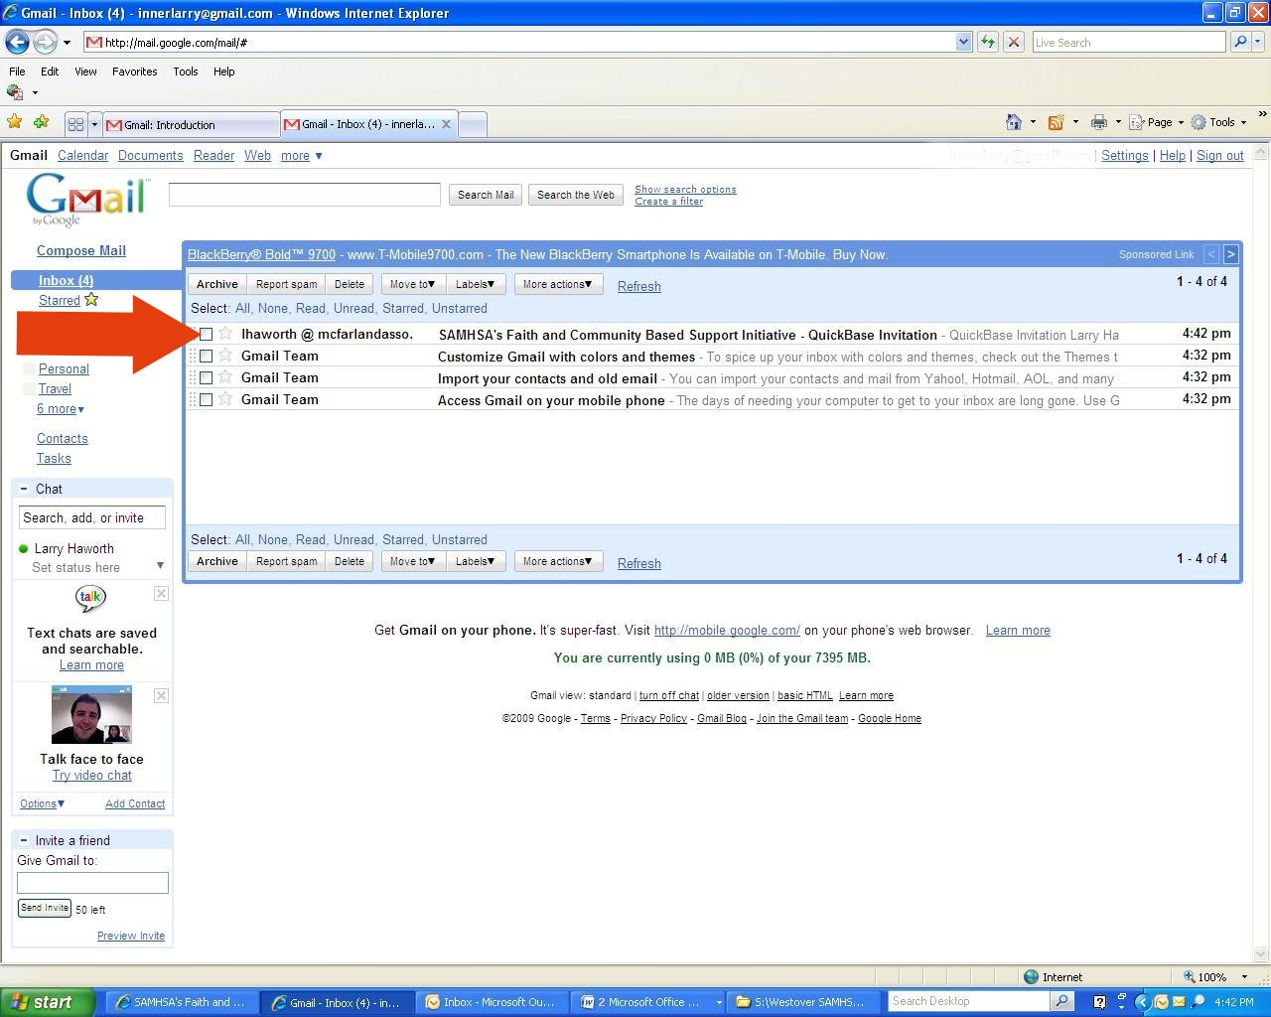
Receiving Your Invitational Email

Slide 4
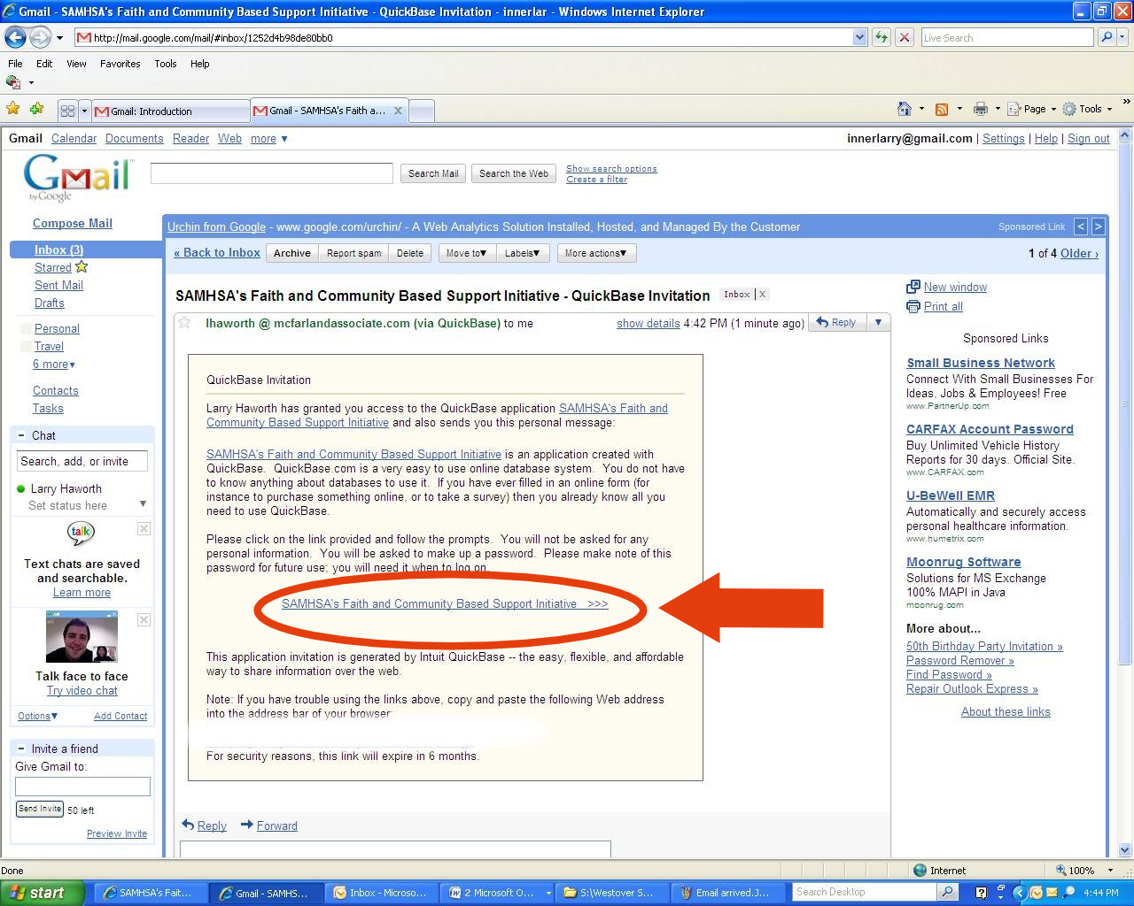
Opening Your Invitational Email

Slide 5
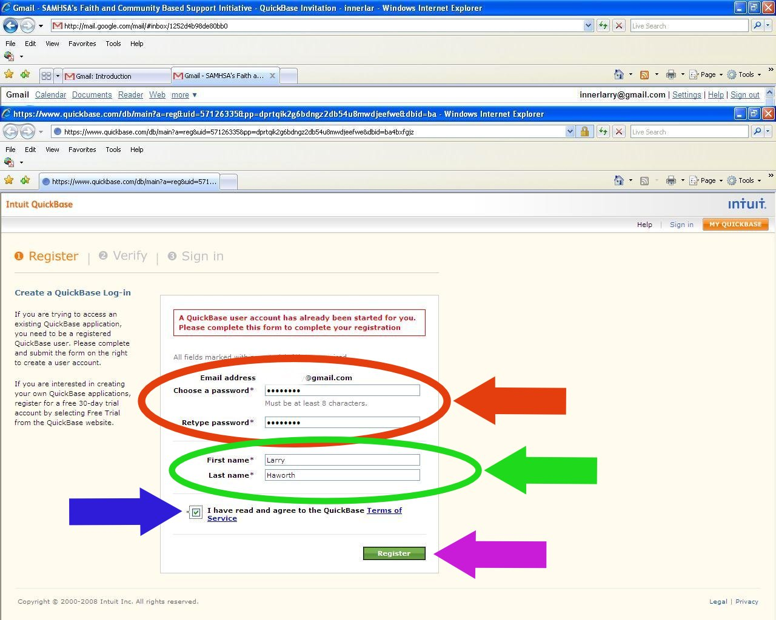
Registering With QuickBase

Slide 6
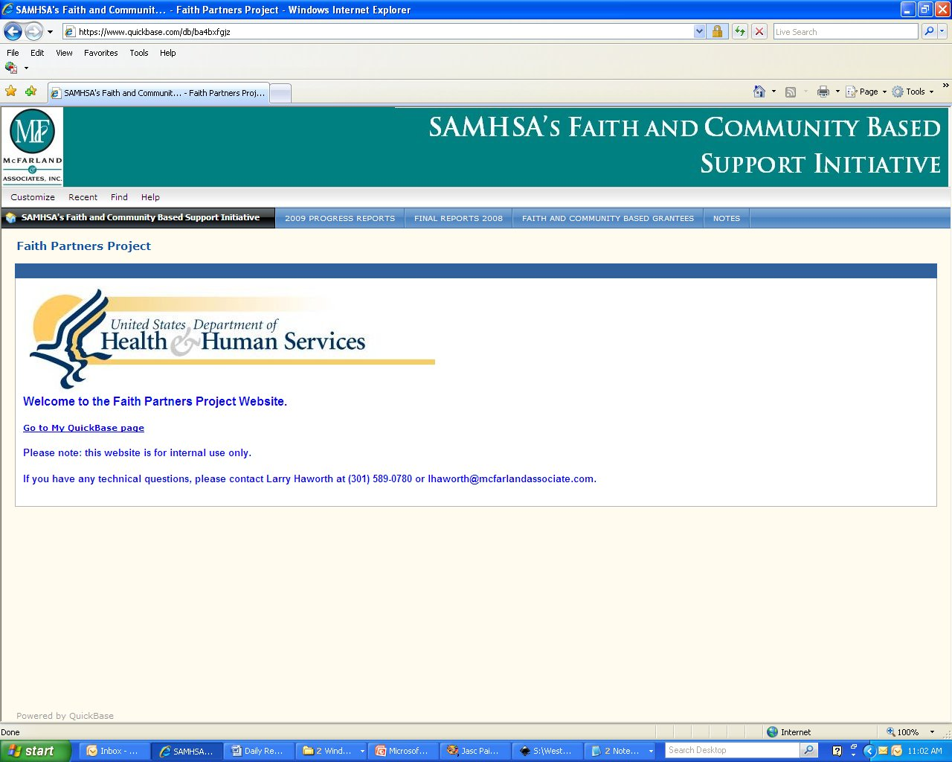
The Overview Page

Slide 7
Saving the Page to Your Favorites

Slide 8
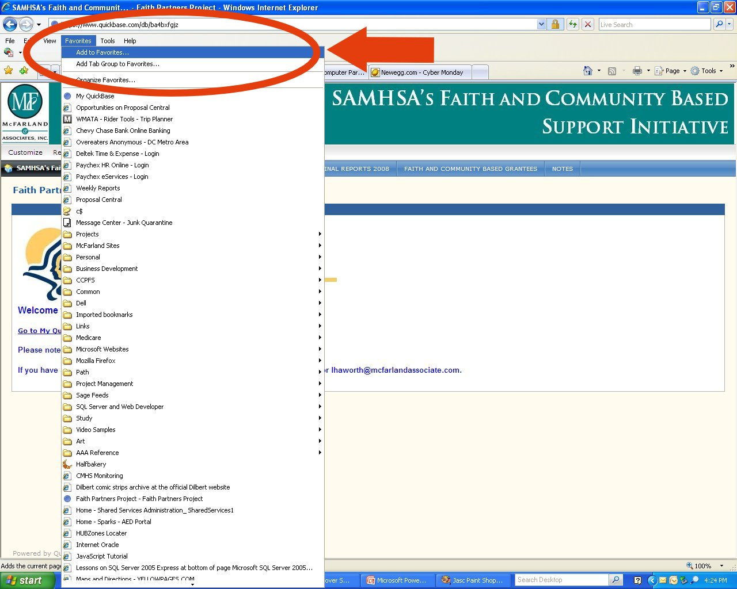
Saving to Favorites in Internet Explorer

Slide 9
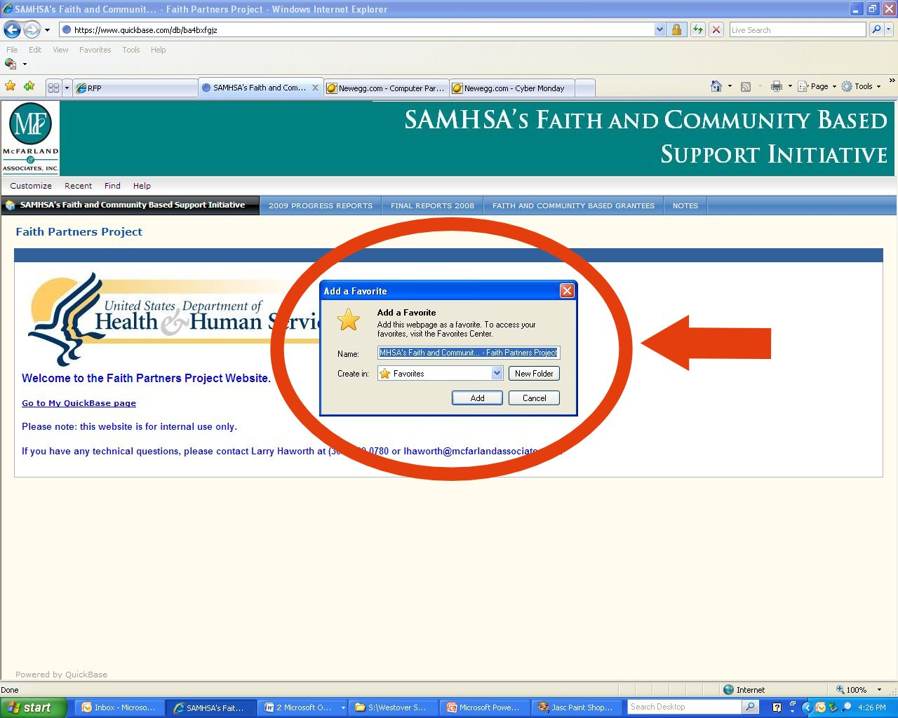
Saving to Favorites in Internet Explorer 2

Slide 10
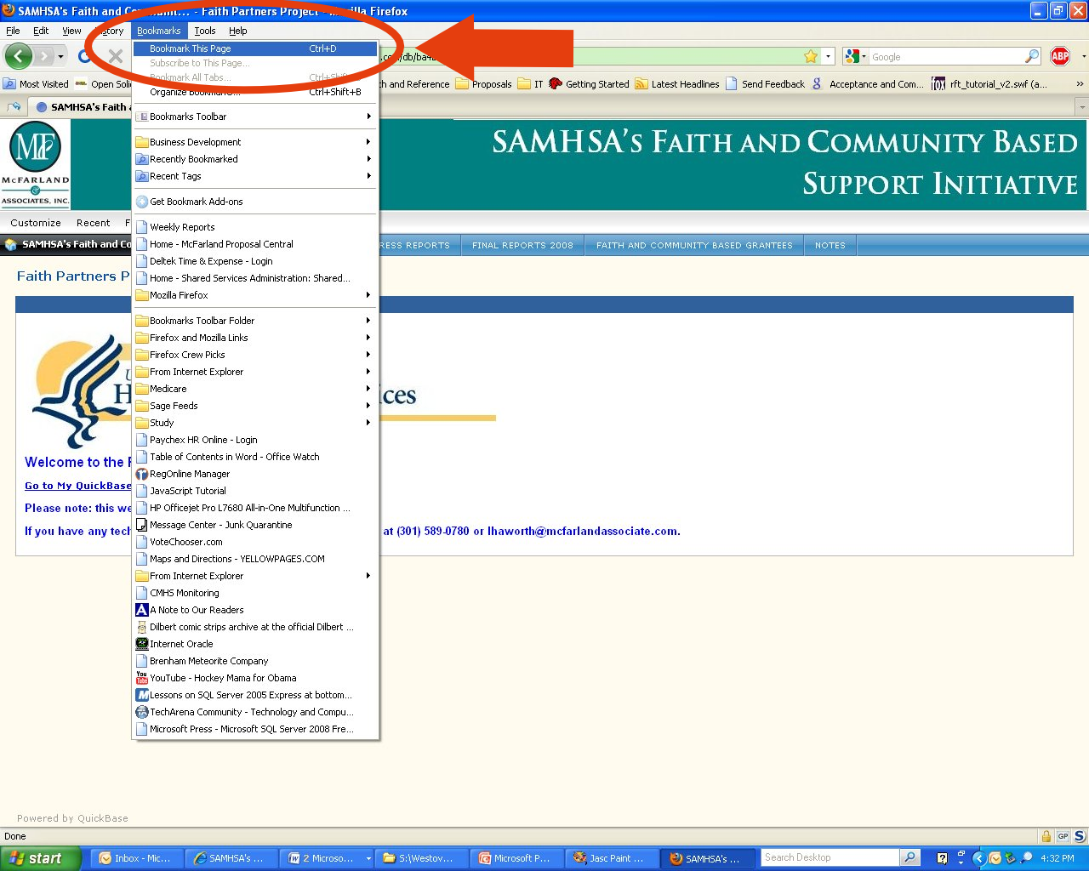
Saving to Bookmarks in Firefox

Slide 11
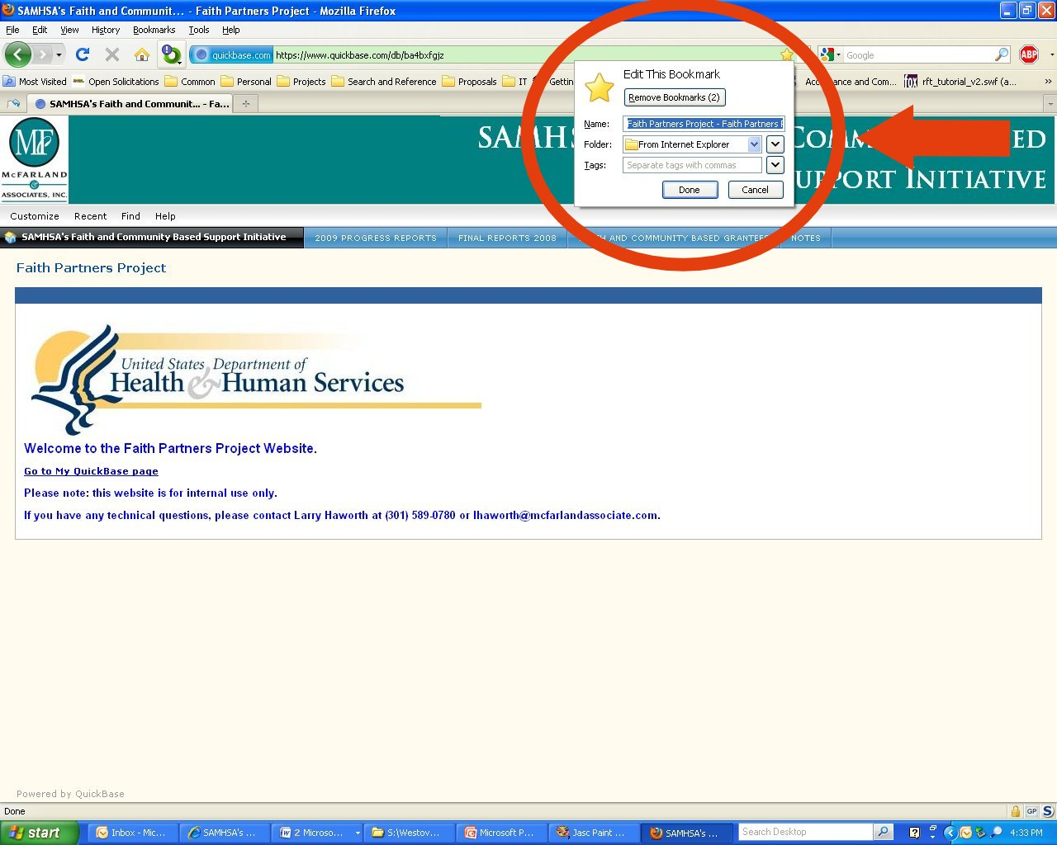
Saving to Bookmarks in Firefox 2

Slide 12
Accessing QuickBase the 2nd Time and Afterwards

Slide 13
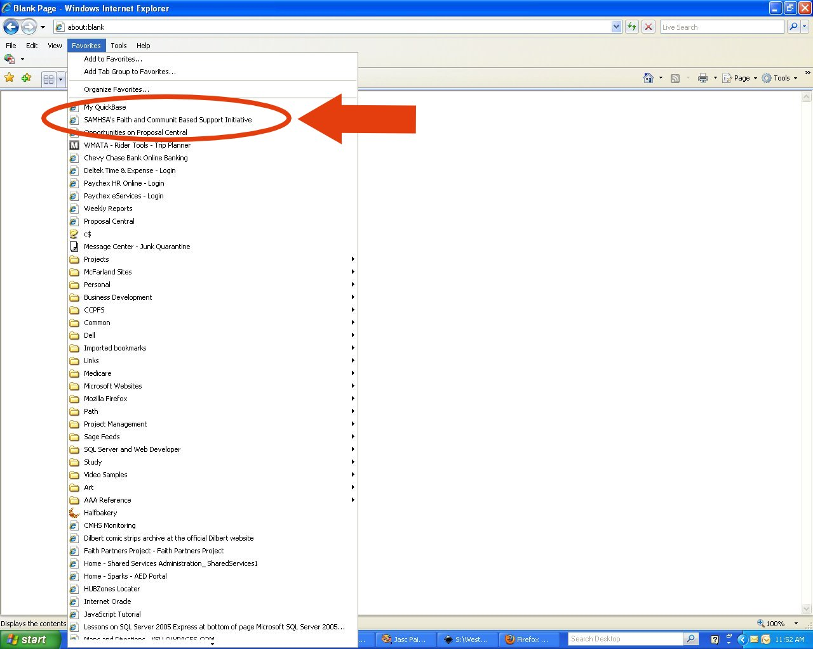
Going to QuickBase from Internet Explorer

Slide 14
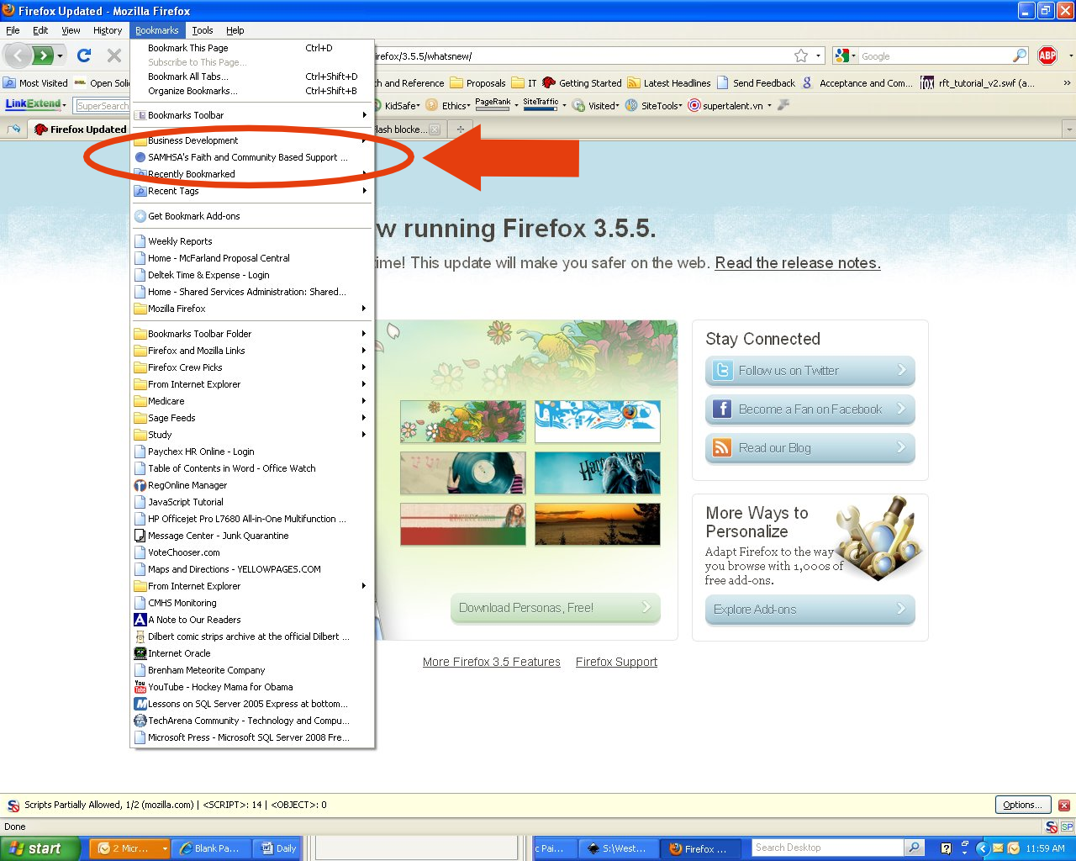
Going to QuickBase from Firefox

Slide 15
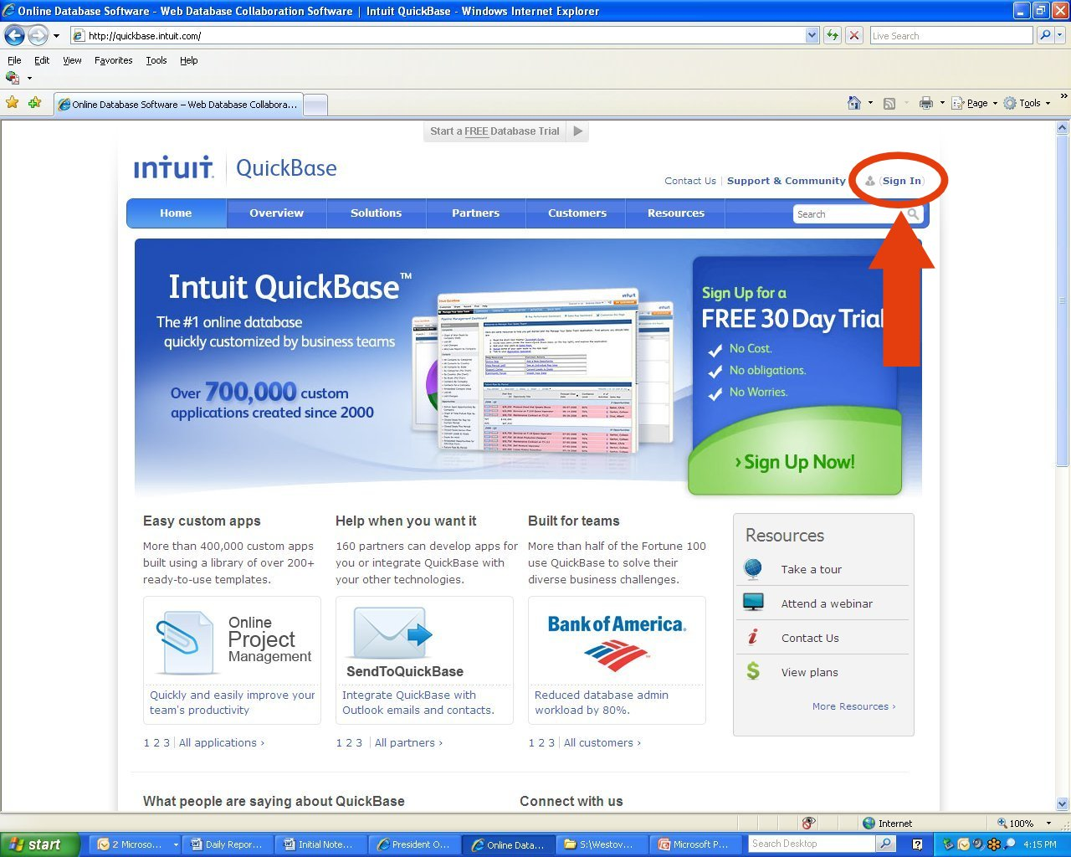
Signing In from QuickBase.com

Slide 16
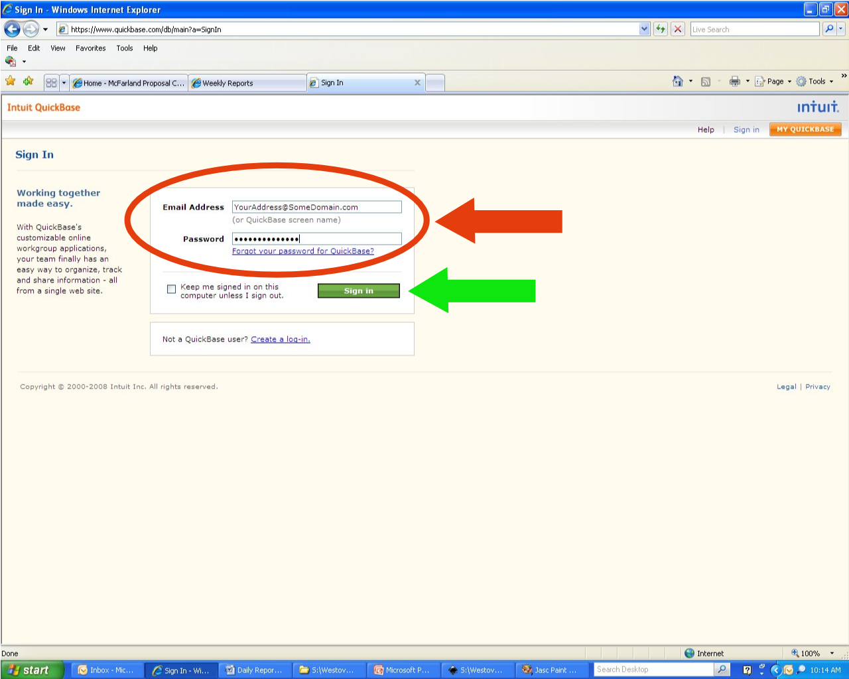
Signing In from QuickBase.com 2

