Slide 1

Printing Your Reports in QuickBase
SAMHSA’s Faith and Community Based Support Initiative

Slide 2
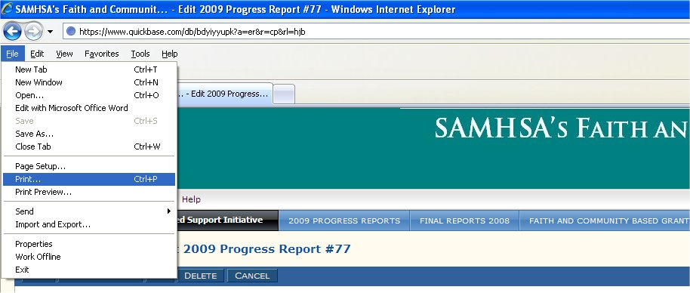
Print from Your Browser
There are two ways to print your report. One is to print it from your browser’s File menu. To do this, go to the File menu and select “Print…” The problem with this is that it will only print the part of the report currently visible on your computer screen. It will not print the whole report if the report is too long to fit in your computer screen.
Notes:
The My QuickBase page
Says “My QuickBase” at the upper left corner

Slide 3
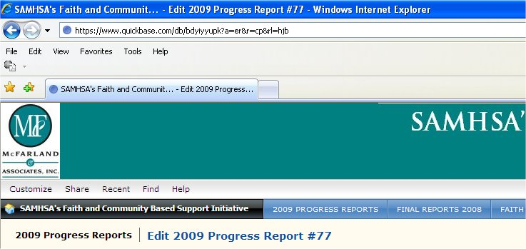
Print from Your Browser
The better way is to click on the Customize menu on the far left of your QuickBase page, above the black button.
Notes:
The My QuickBase page
Says “My QuickBase” at the upper left corner

Slide 4
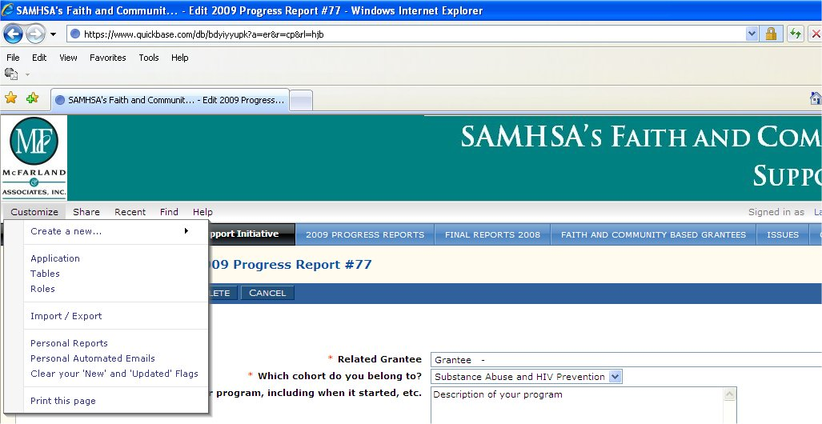
Print from Your Browser
Select “Print this page” from the bottom of the menu. This will print the entire length of the report.
Notes:
The My QuickBase page
Says “My QuickBase” at the upper left corner

