Slide 1

Saving and Resuming Your Work
SAMHSA’s Faith and Community Based Support Initiative

Slide 2
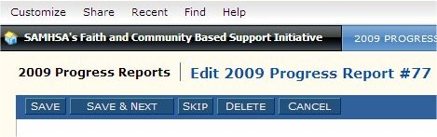
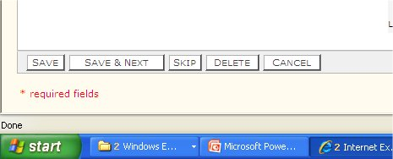
Save a Report
Click on the Save button at the top or bottom of the report
Top of the report
Bottom of the report

Slide 3
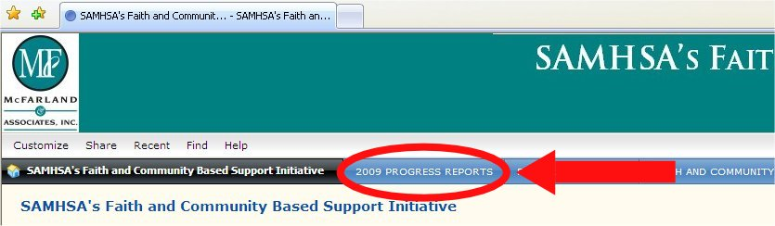
Resume Work on Your Progress Report
Click on the blue “Progress Report” button to the right of the black button.

Slide 4
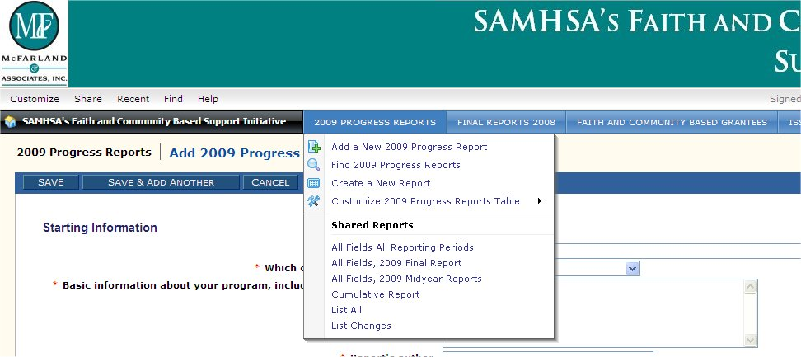
Resume Work on Your Progress Report
In the dropdown list select “List All”

Slide 5
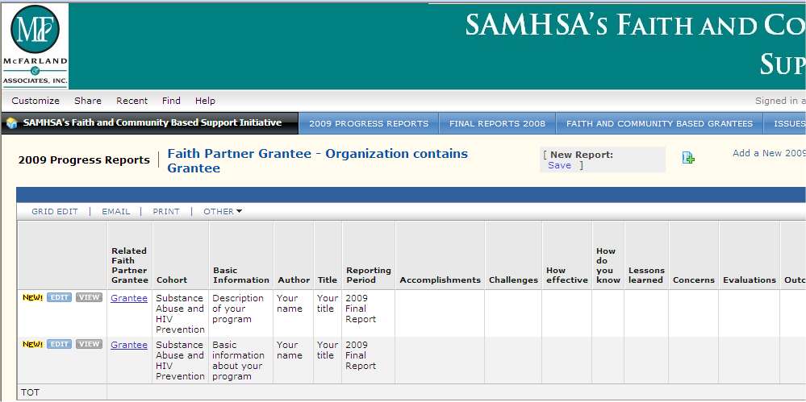
Resume Work on Your Progress Report
The Progress Reports are displayed in rows, one report to a row. At the left of each row are 2 buttons that say “Edit” and “View”.
  Click the Edit button of the report you want to edit

Slide 6
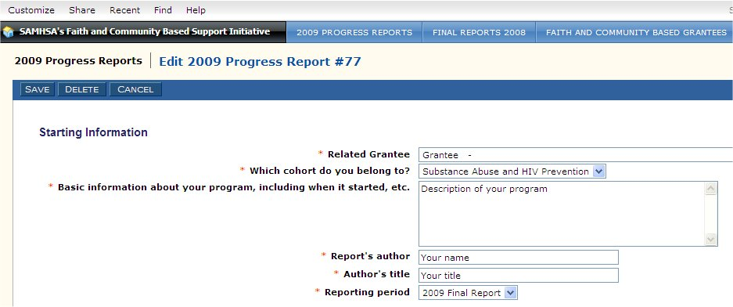
Resume Work on Your Progress Report
The Progress Report you selected will be displayed, ready for editing.

