Slide 1

Adding a Document to Your Report
SAMHSA’s Faith and Community Based Support Initiative

Slide 2
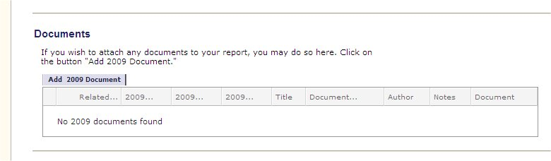
Add a Document
At the bottom of the Progress Report, click on the button that says “Add Document”
Notes:
The My QuickBase page
Says “My QuickBase” at the upper left corner

Slide 3
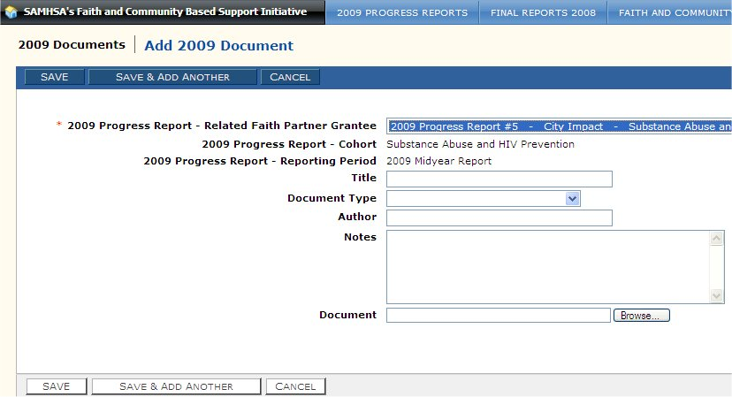
Add a Document
Fill in the information about the document, it’s title etc.
Notes:
The My QuickBase page
Says “My QuickBase” at the upper left corner

Slide 4
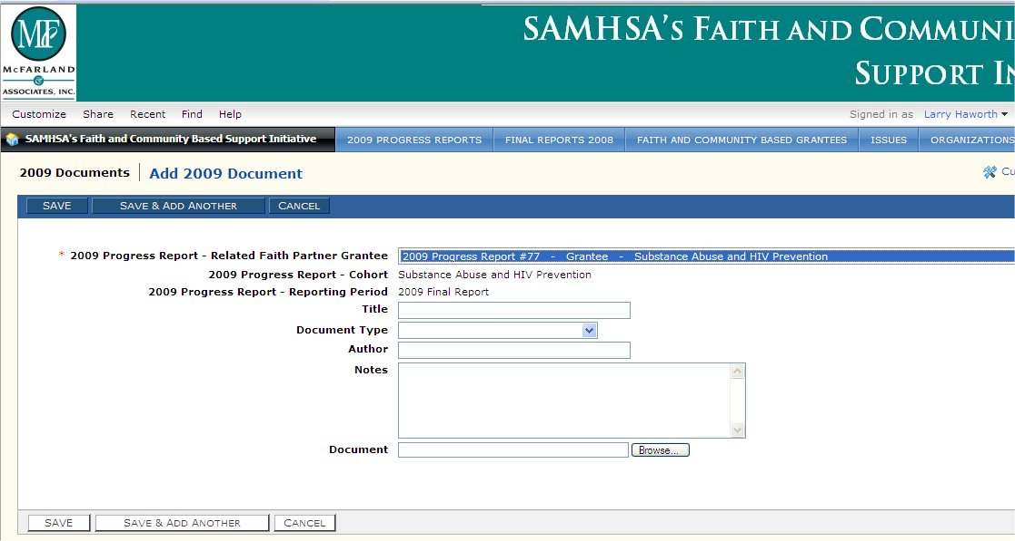
Add a Document
By the Document field, click on the Browse button.
Notes:
The My QuickBase page
Says “My QuickBase” at the upper left corner

Slide 5
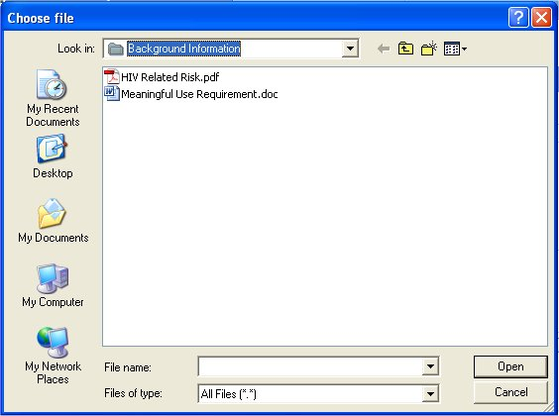
Add a Document
Navigate to the file you want to upload
Notes:
The My QuickBase page
Says “My QuickBase” at the upper left corner

Slide 6
Add a Document
Select the file
Notes:
The My QuickBase page
Says “My QuickBase” at the upper left corner

Slide 7
Add a Document
Click Open
Notes:
The My QuickBase page
Says “My QuickBase” at the upper left corner

Slide 8
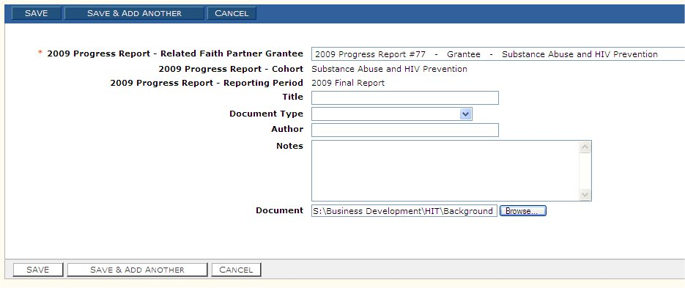
Add a Document
Click Save on the upper left or bottom left of the form
Notes:
The My QuickBase page
Says “My QuickBase” at the upper left corner

Slide 9
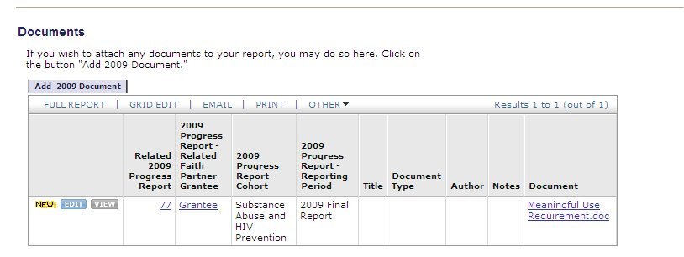
Add a Document
Your newly attached document now appears in the list of documents attached to the report.
Notes:
The My QuickBase page
Says “My QuickBase” at the upper left corner

Slide 10
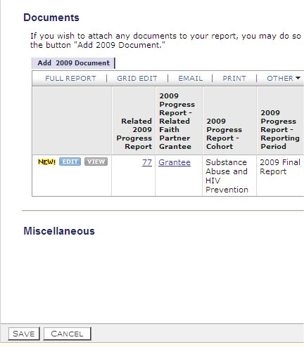
Add a Document
Don’t forget to save your changes to the Progress Report by clicking the Save button
Notes:
The My QuickBase page
Says “My QuickBase” at the upper left corner

