Slide 1

Known Issues
SAMHSA’s Faith and Community Based Support Initiative

Slide 2
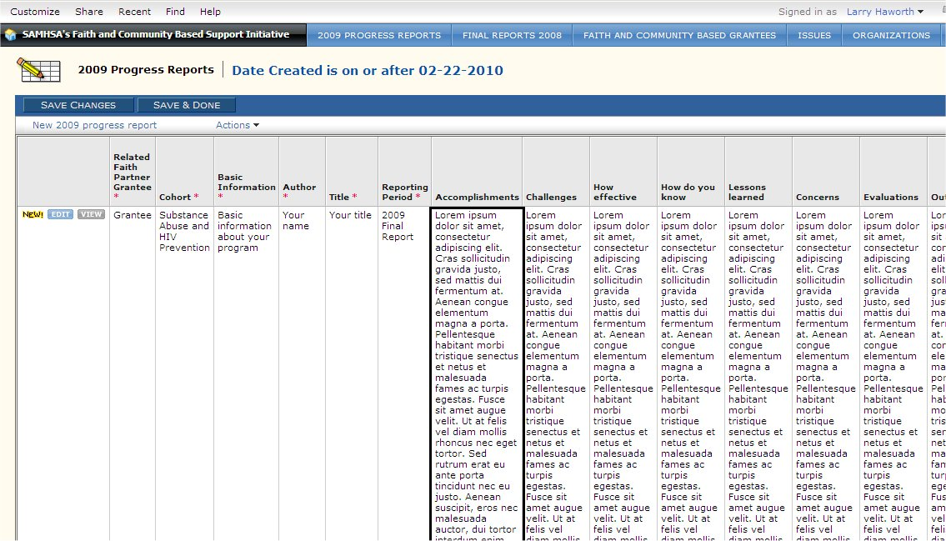
Browser
Internet Explorer works better than Firefox for some screens such as reports with long columns filled with text.
Notes:
The My QuickBase page
Says “My QuickBase” at the upper left corner

Slide 3
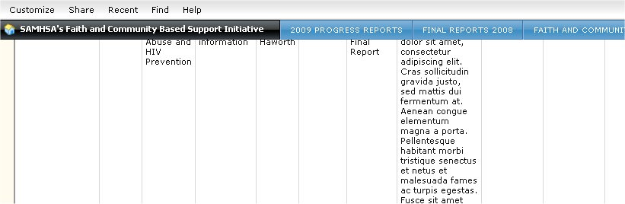
Browser
When you scroll down in Firefox, the heading row disappears, making it difficult to remember which row is which – that is, what data you’re looking at.
Notes:
The My QuickBase page
Says “My QuickBase” at the upper left corner

Slide 4
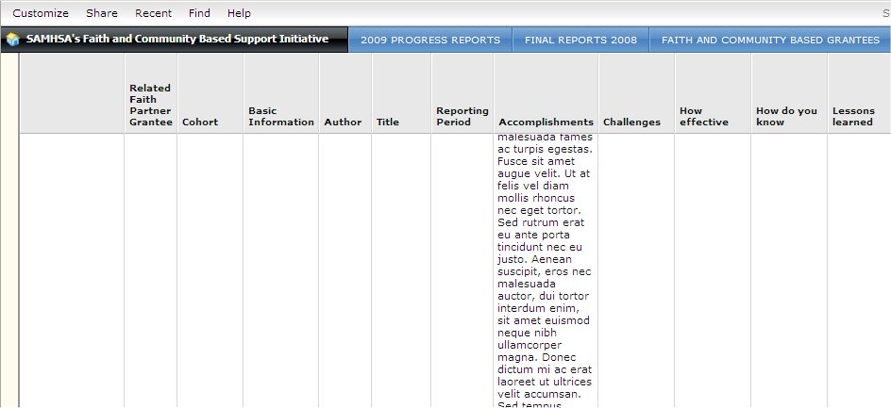
Browser
But when you scroll down in Internet Explorer, the heading row stays in place, making it easier to tell where you are.
Notes:
The My QuickBase page
Says “My QuickBase” at the upper left corner

